Slide 1
MassHealth Redetermination Campaign
Audience: Metrowest Health Foundation’s stakeholders
Maria R. Gonzalez Albuixech, Project Director, MassHealth Redetermination Campaign

Slide 2
Health Care For All
Direct Service
  Consumer HelpLine
Policy
  Advocacy & Coalitions
Community
  Outreach & Organizing

Slide 3
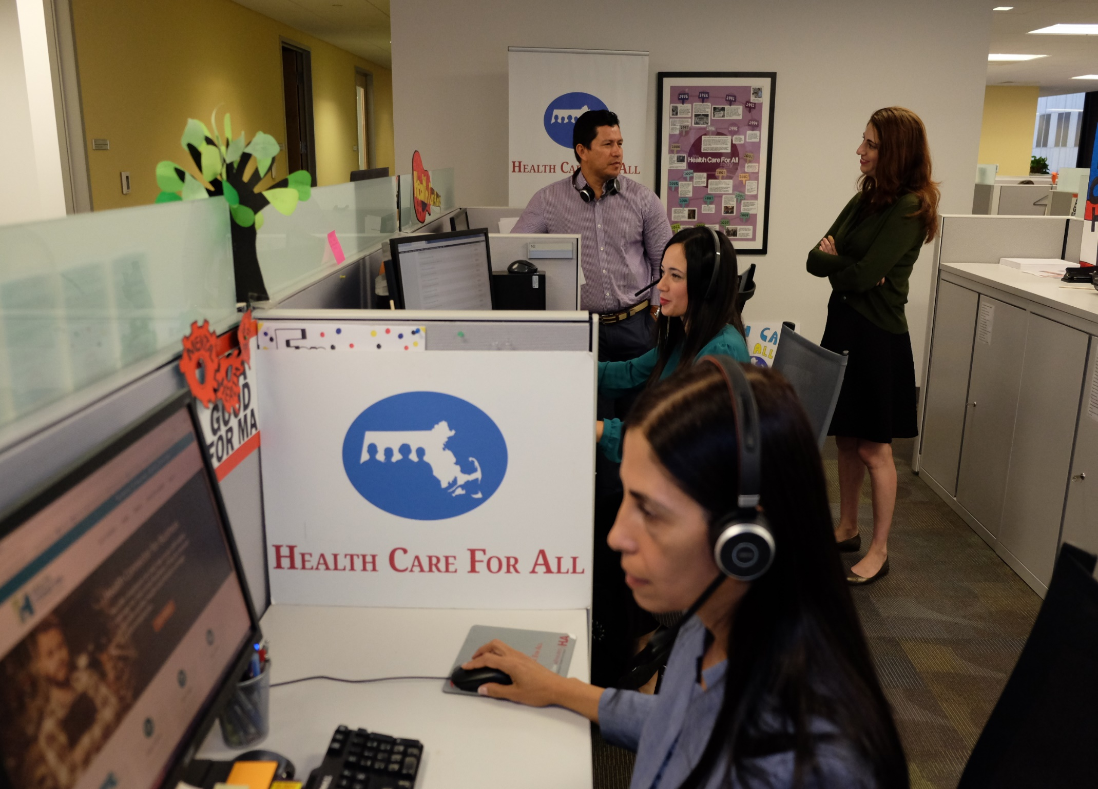

HelpLine

Slide 4
HCFA HelpLine
1-800-272-4232
https://hcfama.org/health-insurance-help/
English / Spanish / Portuguese​/ French/ Haitian Creole
​
Mon – Thurs: 7 am – 5 pm,
Friday: 8 am – 5 pm
HelpLine Counselors provide help to:
Apply for health coverage
Answer health insurance questions
Troubleshoot health insurance issues
Navigate the health care system
Refer to additional resources (e.g. partner organization Health Law Advocates)
Set-up Medicare and supplemental coverage

Slide 5

Background
​
MassHealth members have been protected from losing coverage or downgrades to benefits (federal “continuous coverage” requirement) since March 2020. That grace period has ended.
MassHealth will resume the renewal process beginning April 1, 2023.

Slide 6
The Challenge
An estimated 2.3 million Massachusetts residents (MassHealth members) must be renewed, or they may be at risk of losing their health coverage.
MassHealth will have 12 months to redetermine eligibility for all members.
Renewals will happen on a rolling basis from April 1, 2023 – March 31, 2024.
Some members will be automatically renewed based on data MassHealth already has.

Slide 7

The Process
Members will receive a blue renewal envelope from Mass Health when it is time for them to renew.
They will have 45 days to respond. If they don’t take action, their coverage could be terminated or downgraded.
Members stay insured until renewed.
If they have been auto-renewed, they will receive notice from MassHealth

Slide 8
What Do MassHealth Members Need to Do Now?
They need to update their information and report household changes so they don't miss important information/notices from MassHealth.
That information includes:
  Address, language, phone number, and email
  Any household changes: a new job, address, income, disability status, or pregnancy.

Slide 9
What Do MassHealth Members Need to Do Now?
How do MassHealth members update information and report changes?
All members can report a change by calling MassHealth at (800) 841-2900 (TTY: 711).
Members can also update their information in-person, by mail, or by fax.
People who prefer online can go to: https://www.mass.gov/how-to/report-changes-to-masshealth

Slide 10



MassHealth Redetermination Campaign
​
Thanks to support from the state legislature, HCFA is partnering with MassHealth and the Health Connector on a large-scale public information campaign to ensure Massachusetts residents keep their coverage and to reinforce information about COVID vaccinations.

Slide 11
Where: 15 Municipalities (reaching 1.3M)
Boston+
Brockton
Chelsea
Everett
Fall River
Framingham
Lawrence
Lowell
Lynn
Malden
New Bedford
Quincy
Revere
Springfield
Worcester
+Boston will include: Dorchester, East Boston, Jamaica Plain, Mattapan and Roxbury

Slide 12
Populations and Languages
Culturally and linguistically appropriate campaign
Materials and communications in nine languages to reach target populations and adapted to ensure accessibility
  Arabic
  Cape Verdean Kriolu
  Chinese (Mandarin)
  English
  Haitian Creole
  Khmer
  Portuguese
  Spanish
  Vietnamese

Slide 13

The Message After April 1, 2023
  MassHealth members: You need to renew your coverage this year.
Take 3 steps to renew your coverage
  Update your information with MassHealth
  Check your mail for the blue envelope
  Respond to MassHealth

Slide 14
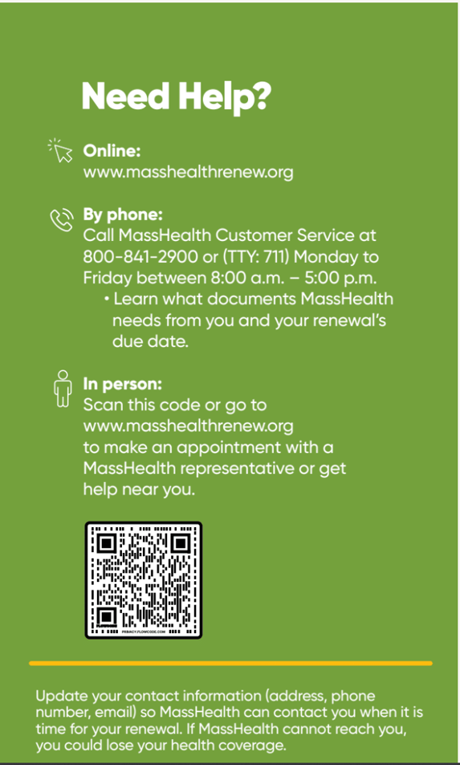
How People Can Get Help with Renewals?
  Phone: People can call MassHealth customer service (800) 841-2900
  Online: www.masshealthrenew.org
  In person: People can get in-person help in their municipality and language via HCFA’s website
    Connects them to enrollment assisters who can meet with them and walk them through the enrollment process

Slide 15



Campaign Strategy
Our multi-pronged approach will include:
1. Collaboration and engagement with community- (CBOs) and faith-based organizations (FBOs)
3. One-on-one outreach via door knocking/canvassing
2. A communications campaign that includes ads in targeted multilingual community-oriented outlets (TV, radio, newspapers), digital ads, and media outreach

Slide 16


CBO/FBO Partnerships
Community- and faith-based organizations from each of the 15 municipalities + organizations serving key populations, including people living with disabilities, people experiencing homelessness, and older adults
CBO/FBOs will deliver visibility activities and events:
Joint outreach events with hospitals, local health centers and other stakeholders that reach targeted populations
Community and religious institution events
Tabling and posters in areas of high pedestrian traffic and at community and faith-based events
Business walks to distribute info and materials to local stores and businesses

Slide 17
Canvassing Operation
In a very targeted geographic area of each of the 15 target municipalities, canvassers will knock on every accessible door to inform residents of the requirement to renew their MassHealth.
Canvassers will be recruited from the target municipalities; many will be able to converse in priority languages.
Canvassers will have info for adults 65+

Slide 18
Ads: Focus on Community Media and Digital
NEWSPAPERS
  English and multilingual/multicultural outlets
  Traditional print
  Print and online (ads will appear in both)
  Online
RADIO
  Multilingual shows – Spanish, Haitian Creole, Portuguese + English
  Radio stations
  Independent producers
DIGITAL
  Geotargeting
  Drives people to www.masshealthrenew.org
TV – Commercial
  Univision - Spanish
  Telemundo - Spanish
  Globo* - Portuguese
TV - Local Access
  All 15 communities

Slide 19
SPRING 2023
SUMMER 2023
FALL 2023
WINTER 2023/2024
Campaign Timeline: Renewals Start in April
March—June
First Round Grants (~30-40 CBOs) + Activities
August – November
Second Round Grants (~20 CBOs) + Activities
CBO/FBOs
July Break
Mid-March—August
Print, Radio, TV, Digital Media Buys
MEDIA
April 1 – July 31 Canvassing
CANVASSING
19

Slide 20



Opportunities for Collaboration
​
Share/reproduce marketing materials/resources
Work with members to update their info with MassHealth
Share thoughts to improve process

Slide 21
Special Support for Adults Age 65+ Needed
Older adults must use a complicated paper application (SACA) and will require additional assistance.
    This will be especially challenging for people receiving LTSS.
Very few enrollment assisters are trained on the paper application for age 65+ and/or their caregivers.

Slide 22
Supporting Adults Age 65+
MassHealth has shortened the application and is adding staff who can help.
There will be marketing materials targeting 65+ and individuals receiving LTSS, which we will disseminate via the Campaign
MassHealth will increase percentage of CACs trained in the SACA and 65+ eligibility and renewals.
MassHealth and EOEA are partnering to increase application assisters at Aging Services Access Points (ASAPs) and to train dedicated staff on the SACA.

Slide 23
Meeting the Demand for Assistance
HCFA will receive a grant from MassHealth to build renewal support capacity at CBOs, expanding access to Assisters particularly for adults 65+, people with disabilities, people experiencing homelessness, and immigrants.
HCFA is exploring mobile Certified Application Counselors (CACs) to reach ‘CAC’ deserts.
The Health Connector will also be deploying mobile units across the state to locate at homeless shelters, community events serving special populations, and high-traffic areas.

Slide 24
Questions?
Thank you!
Please feel free to reach out:
mgonzalez@hcfama.org
kmelley@hcfama.org
hfrigand@hcfama.org
www.hcfama.org

