Slide 1
Project Bread’s FoodSource Hotline
Khara Burns
Senior Director of SNAP Outreach Programs

Slide 2
Our Purpose
Project Bread’s Hotline connects people and communities in Massachusetts to reliable sources of food while advocating for policies that make food more accessible- so that no one goes hungry.

Slide 3
Food insecurity doubled during the pandemic.
The Facts
16.6% of all households & 21.5% of households with children in Massachusetts are food insecure
Prior to the pandemic, household food insecurity in Massachusetts was at 8.2%.
The coronavirus pandemic fueled a hunger crisis unlike any other in our lifetime, at its peak rendering 19.6% of households' food insecure. Food insecurity declined from that peak, but it is climbing again as government benefits sunset and inflation stretches budges.

Slide 4
PHE Impact on SNAP Households
Over 600,000 households impacted
Average loss of $151 Emergency Allotment
Last Emergency Allotment on March 2nd, 2023
Pending- $282 million-dollar supplemental budget filed
What should participants know?
This is not a DTA decision
You are still enrolled and have done nothing wrong
It is important to report changes to DTA via:
  DTA Connect Online Portal or Mobile App
  DTA Assistance Line 877-382-2363
  Visit a local office

Slide 5
Specialty Verifications to Increase Your SNAP
What? | Who? | How?
Dependent Care | Families with children who use childcare services while at work or school | Send a receipt or bill
Child Support Payment | Parent that has court ordered child support payments | Send court order or legal agreement, receipt or proof of payment
Medical Expenses including Adult Day care | Older adults 60+ or persons with disabilities | Send bill for out-of-pocket medical expenses. Some expenses can be self declared if under $190

Slide 6


Slide 7
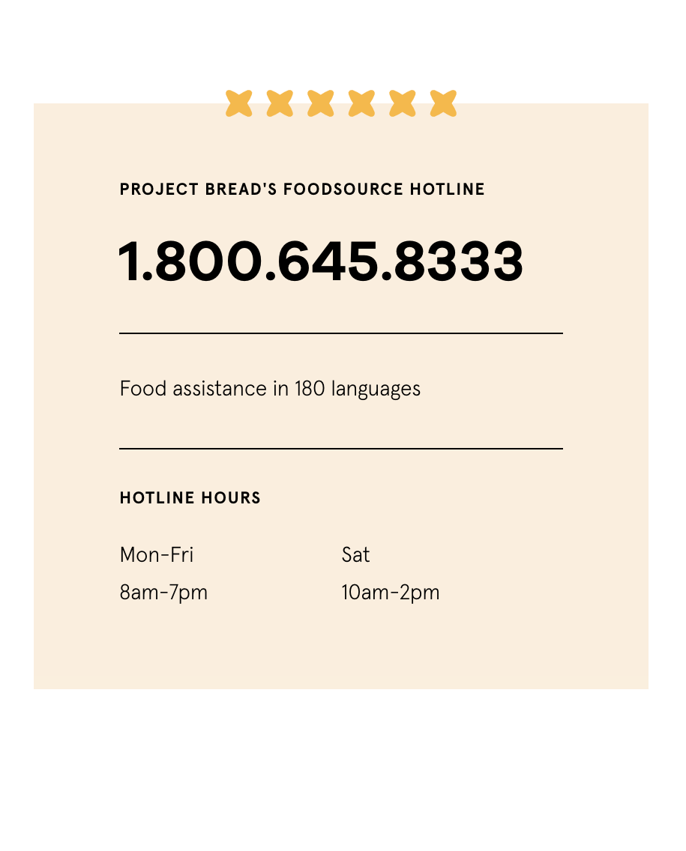
ABOUT / FOODSOURCE HOTLINE
Project Bread’s FoodSource Hotline
One-stop-shop for food assistance in Massachusetts.
Free & confidential
Bilingual Hotline Counselors
Extended Hours for working families
Residents can Live Chat or Text a counselor online in English or Spanish: GettingSNAP.org
THE FACTS
16.6% of households
Notes:
Project Bread’s FoodSource Hotline is a statewide (toll-free) information and resource service designed to connect people in Massachusetts with a variety of food resources in their local community.

Slide 8
OUR SERVICES
Screenings for SNAP Eligibility
Over-the-phone SNAP application assistance and follow up with applicants throughout the process and navigating DTA Connect
Information to pending or current SNAP recipients and those who want to ensure they are maximizing benefits
Referrals to community food programs
Referrals to other assistance programs such as WIC, school meals, housing, and utility assistance
Information on the Healthy Incentives Program (HIP) for SNAP recipients and how to utilize the program

Slide 9
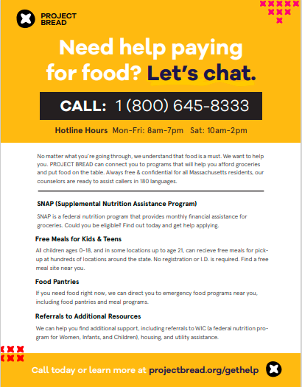
ABOUT / PROMOTING RESOURCES
Outreach Materials
Download and share instantly OR order free printed materials
Languages include English, Spanish, Portuguese, Chinese, Haitian Creole, Vietnamese, and Cape Verdean Creole, and more!
Find Flyers, Bag stuffers, Posters, Social media toolkits, Template emails, robocalls and texts
If you need specific materials or languages—connect with us!
https://www.projectbread.org/resource-directory

